Slide 1






DEEP LEARNING LAB PROJECT PRESENTATION
Liam Bopanna M M - 210962178
Pranay Jaju - 210962146

Slide 2




Table of contents
Introduction
Our Project
Pipeline
Results
Conclusion

Slide 3



Introduction
Cryptocurrencies have emerged as a significant and dynamic asset class, attracting attention from investors, traders, and researchers alike. Among the myriad of cryptocurrencies, Ethereum (ETH) and Binance Coin (BNB) have emerged as prominent players in the digital asset ecosystem. Ethereum, known for its smart contract functionality and decentralized applications, has established itself as a foundational platform for blockchain innovation. On the other hand, Binance Coin, the native cryptocurrency of the Binance exchange, has seen remarkable growth due to its utility within the Binance ecosystem and innovative features such as token burns and staking.

Slide 4

CRYPTO PRICE PREDICTION USING GAN
OUR PROJECT
Leveraging advanced deep learning techniques, this project focuses on the implementation of Wasserstein Generative Adversarial Networks (WGAN) to forecast the prices of Ethereum and Binance Coin. To improve model prediction we use a Variational Autoencoder (VAE) to perform feature augmentation to enrich the input features using the latent space encoding. By training the GAN model on historical price data, the project aims to create realistic synthetic data that that closely mimics the real world behaviour of the crypto token price.

Slide 5


PIPELINE
1
2
3
4
Data Acquisition
Data Preprocessing and Augmentation
Dataset Creation
Price Prediction

Slide 6
1
2
3
4
Data Acquisition
Data Preprocessing and Augmentation
Dataset Creation
Price Prediction
Data is collected from the Yahoo Finance API.
Contains records of daily coin prices including the Opening price, Maximum price, Minimum price, Close price and Volume.

Slide 7
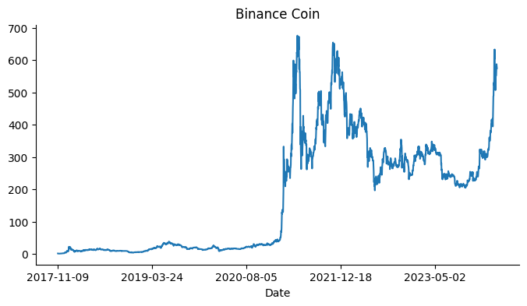
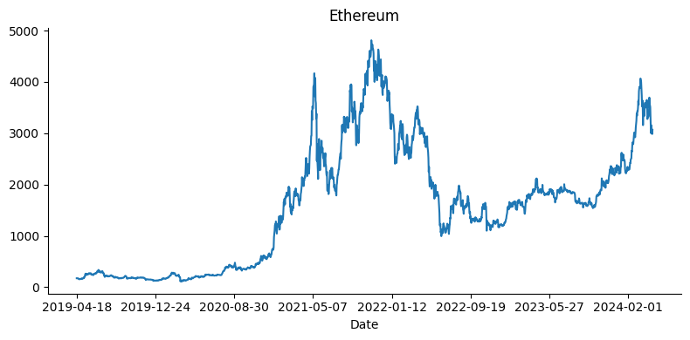
1
Data Acquisition
The Data is taken from the yahoo finance API for both the chosen crypto tokens are acquired for the last 5 years. The dataset contains the opening, closing, High and Low price for the day as well as the Volume of the token.
Target variable : Close price
Independent variables :
Open price
Highest Price
Lowest Price
Volume

Slide 8
1
2
3
4
Data Acquisition
Data Preprocessing and Augmentation
Dataset Creation
Price Prediction
Dataset is Scaled using Min-Max Scaler to standardize the data and Feature Augmentation is performed using VAE to enrich the data using the latent space encoding

Slide 9
2
Data Preprocessing and Augmentation
Variational Autoencoders (VAEs) are employed as a feature augmentation technique to enhance the predictive capabilities of cryptocurrency price forecasting models.
Here's how VAEs contribute to the project:
Feature Extraction:
VAEs are utilized to extract meaningful and informative features from the raw historical price data of Ethereum and Binance Coin. By learning a higher-dimensional representation of the input data, VAEs capture important patterns and relationships that may not be apparent in the original feature space.
Feature Augmentation:
The introduction of stochasticity(proabablistic prediction) during the encoding process promotes a smooth and continuous latent space representation, leading to noise regularization that prevents overfitting and enhances the model's robustness to variations in the data.

Slide 10
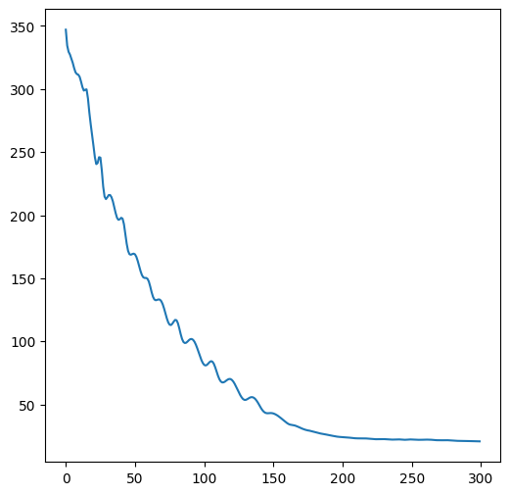
2
Data Preprocessing and Augmentation
Model Architecture:
input size : 6
hidden layer : 3
hidden size : 400
Latent space size : 10
Variational Autoencoders Training:
During training, the code processes each batch of data in the training loader. For every batch a forward pass through the model generates the output, latent space, mean, and log variance. The KL divergence loss is computed using the mean and log variance of the latent space, along with the binary cross-entropy loss between the output and the original input. Backpropagation is then performed updating the model parameters using the optimizer.
KL divergence (Kullback-Leibler divergence), is a measure of how one probability distribution diverges from a second, expected probability distribution. It's used to quantify the difference between two probability distributions.
Training loss vs epoch
kl_divergence = 0.5* torch.sum(-1 - logVar + mu.pow(2) + logVar.exp())

Slide 11
1
2
3
4
Data Acquisition
Data Preprocessing and Augmentation
Dataset Creation
Price Prediction
Encoded features are concatenated with the original features and creating sliding windows of data for sequence prediction tasks. The sliding windows are used to train models that predict future values based on past observations.

Slide 12

3
Dataset Creation
Appending Latent features:
Latent encoding from the VAE are added to the features of the input data
Time Series Dataset:
With a window size of 3, the sliding window method processes the input data by sequentially moving a window of size 3 across the dataset. This window captures three consecutive data points at each step, providing context for analysis or prediction. By sliding across the entire dataset, overlapping sequences of three data points are generated, enabling the model to learn from sequential dependencies and temporal dynamics.
This approach facilitates feature extraction and pattern recognition, enhancing the model's predictive capabilities.

Slide 13
1
2
3
4
Data Acquisition
Data Preprocessing and Augmentation
Dataset Creation
Price Prediction
The dataset assembled is split into training and testing data and used to train the WGAN and hence make predictions.

Slide 14
4
Price Prediction
Generator
Discriminator
Adversarial Training
Evaluation

Slide 15
4
Price Prediction
Generator
The generator architecture consists of three GRU layers, each followed by a Rectified Linear Unit (ReLU) activation function. The first GRU layer accepts input determined by the latent space dimensionality and has a hidden size of 1024 units, while subsequent GRU layers decrease in size to reduce sequence dimensionality. Dropout layers are incorporated to prevent overfitting by randomly dropping units during training. Following the GRU layers, linear layers further diminish the dimensionality of hidden representations, ultimately generating the final output sequence. These components collectively enable the generator to effectively model sequential data and produce synthetic samples with reduced risk of overfitting.
Discriminator
o
Adversarial Training
Erosion 2

Slide 16
4
Price Prediction
Generator
Discriminator
Adversarial Training
Evaluation

Slide 17
4
Price Prediction
Discriminator
The discriminator comprises of a series of convolutional layers followed by linear layers. The initial convolutional layer convolves the input data to extract essential features, progressively increasing the depth and complexity of the representations through subsequent convolutional layers. Each convolutional layer is complemented by a leaky rectified linear unit (Leaky ReLU) activation function, introducing non-linearity to capture intricate patterns in the data effectively. The linear layers further process the extracted features, ultimately producing a single output. Additionally, rectified linear units (ReLU) are employed in conjunction with the linear layers to enhance non-linearity further. The discriminator's primary role is to discriminate between real and fake data samples by assessing the features extracted from the input data.
Discriminator
o
Adversarial Training
Erosion 2

Slide 18
4
Price Prediction
Generator
Discriminator
Adversarial Training
Evaluation

Slide 19
4
Price Prediction
Adversarial Training
Generator Training and Loss: The generator is trained to produce synthetic data samples that closely resemble real data, aiming to maximize the probability that these samples are classified as real by the discriminator. The loss function for the generator typically involves minimizing the output of the discriminator for the generated samples.
Discriminator Training and Loss: The discriminator is trained to differentiate between real and fake data samples, aiming to minimize the difference between its predictions for real and fake samples. In the context of Wasserstein GAN, the discriminator's loss function includes the Wasserstein loss, which measures the difference between the discriminator's predictions for real and fake samples.
Discriminator
o
Adversarial Training
Erosion 2

Slide 20
4
Price Prediction
Adversarial Training
Adversarial Training Nature: Adversarial training involves a competitive process where the generator and discriminator networks strive to outperform each other. The generator generates samples to fool the discriminator, while the discriminator aims to improve its ability to distinguish between real and fake samples. This adversarial competition drives both networks to improve continually.
Nature of Convergence: Convergence is reached when the training process stabilizes, and the generator produces synthetic samples that closely resemble real data, while the discriminator's discrimination performance approaches chance level. At convergence, the Wasserstein loss for the discriminator converges to a stable value, indicating that the discriminator can no longer reliably differentiate between real and fake samples. This ensures that the generator generates high-quality synthetic samples, fulfilling the objective of Wasserstein GAN training.
Discriminator
o
Adversarial Training
Erosion 2

Slide 21
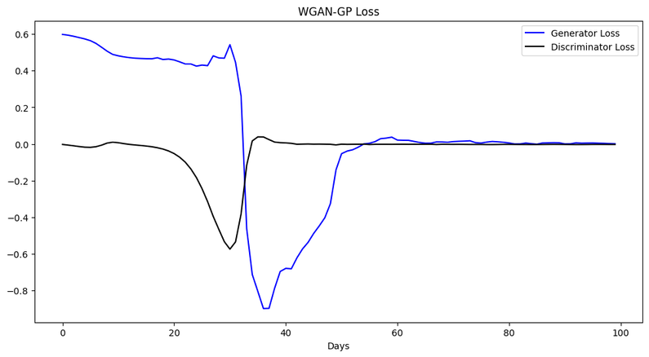
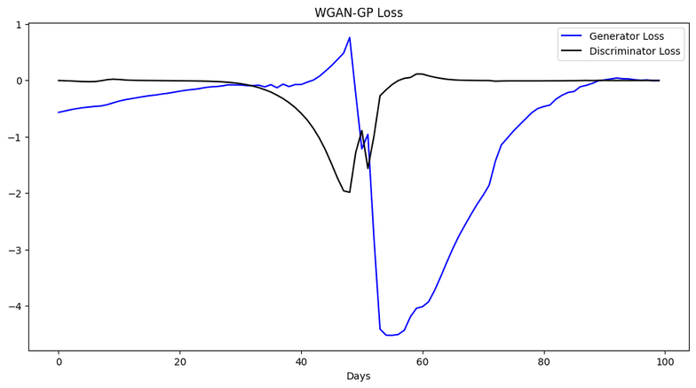
4
Price Prediction
Adversarial Training
Binance Coin
Ethereum
Discriminator
o
Adversarial Training
Erosion 2
Loss vs Epoch
Loss vs Epoch

Slide 22
4
Price Prediction
Generator
Discriminator
Adversarial Training
Evaluation

Slide 23
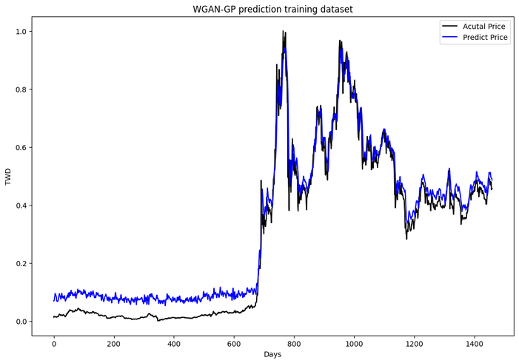
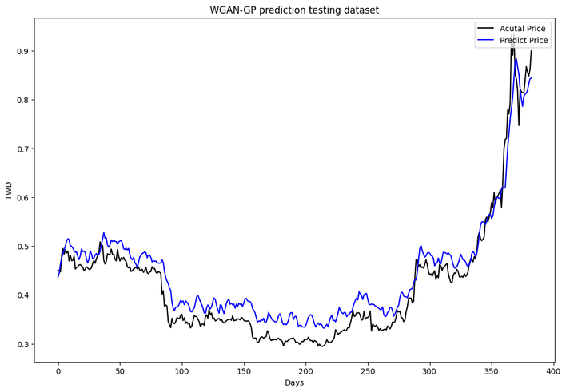
4
Price Prediction
Evaluation
Binance Coin
Discriminator
o
Adversarial Training
Erosion 2
Training RMSE : 0.05396
Testing RMSE : 0.03636

Slide 24
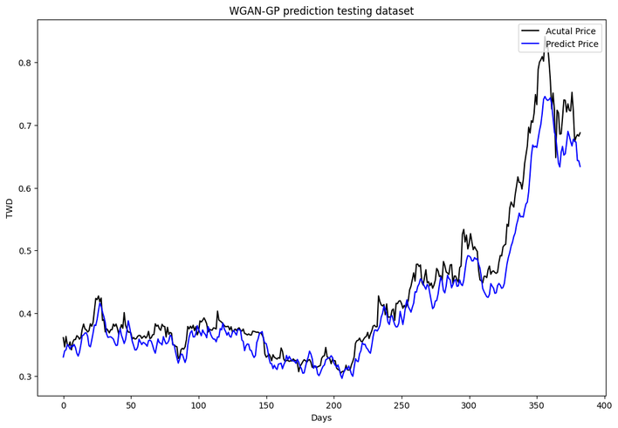
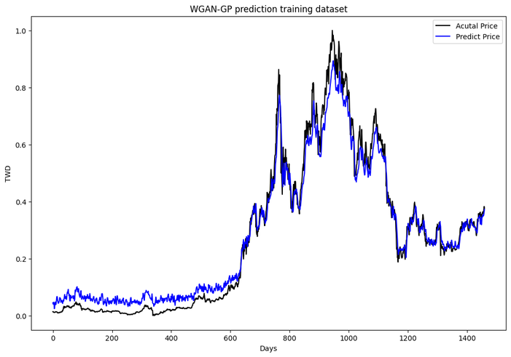
4
Price Prediction
Evaluation
Ethereum
Discriminator
o
Adversarial Training
Erosion 2
Training RMSE : 0.0440
Testing RMSE : 0.0318

Slide 25


Conclusion
This project underscores the suitability of Generative Adversarial Networks (GANs) for cryptocurrency price prediction tasks as well as the advantages of feature augmentation using VAE. By leveraging GANs, we have successfully generated synthetic data samples that closely resemble real cryptocurrency price data. The models demonstrate competitive performance, with the RMSE metric indicating that it outperforms many existing models in the financial prediction domain. This highlights the efficacy of GANs in capturing the complex patterns inherent in cryptocurrency price movements and their potential to enhance predictive accuracy in this domain.

Slide 26



Thank You!
Liam Bopanna M M
Reg no : 210962178
Pranay Jaju
Reg no : 210962146

